Slide 1



Slide 2


Must authenticate sensors to detect tampering!
Couldn’t you have told me earlier?!

Slide 3
ml for cybersecurity
… aware at last that in this world, with great power there must also come – great responsibility …
– Amazing Fantasy #15, Marvel Comics (1962)

Slide 4


Authentication by Secret Questions
Give me your A/C number and answer the following questions
What is your date of birth?
What is your pet’s name?
How many marks did you get in 10th standard exams?
How many cars do you own?
What is your height in mm
SBI31415926535
05th August 2000
Mr. Bud Bud
err … couldn’t hear you clearly
None, so give me that loan!
1700
BANK
USER
I know your pet’s name and DoB from your FB profile!
Uh oh! No way to guess answers to these new questions from the answers I stole!

Slide 5

Authentication by Secret Questions
Using PUFs
Give me your device ID and answer the following questions
10111100
00110010
10001110
00010100
11100011
TS271828182845
1
0
1
0
0
SERVER
DEVICE
How to ensure that these answers are unique and unpredictable?

Slide 6



Physically Unclonable Functions
0.50ms
These tiny differences are difficult to predict or clone
0.55ms
Then these could act as the fingerprints for the devices!
Careful – it is not as though one device is faulty or is doing wrong calculations – its just that the delays are different

Slide 7

A simple switching PUF
It is difficult to create another switch that exhibits the exact same delays
“select” bit
0
1
s
p ms delay
In case you are curious, these switches are implemented using a pair of 2:1 multiplexers and a NOT gate
r ms delay
s ms delay
q ms delay
Correct. However, the switches are consistent, i.e., their delays do not change (too much) over time.
NOT gate

Slide 8
Arbiter PUFs
If the top signal reaches the finish line first, the “answer” to this question is 0, else if the bottom signal reaches first, the “answer” is 1
Question: 1011
1
0
1
1
?

Slide 9
Arbiter PUFs
If the top signal reaches the finish line first, the “answer” to this question is 0, else if the bottom signal reaches first, the “answer” is 1
Question: 1011
1
0
1
1
1
?
Winner!

Slide 10
Arbiter PUFs
If the top signal reaches the finish line first, the “answer” to this question is 0, else if the bottom signal reaches first, the “answer” is 1
Question: 0110
0
1
1
0
Winner!
0
?

Slide 11


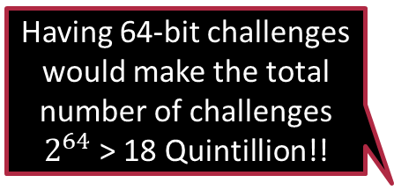
Understanding Arbiter PUFs
Does it matter whether the “red” signal reaches first or the “blue”?
No, the color does not matter – the color was added just for explanation
Why go into all this fuss of having multiple switches?
It increases the number of possible questions and intuition from cryptography theory suggested that it would make it more difficult to guess the answers.
Is it compulsory to have only 4 switches?
Absolutely not. It depends on how long are your “questions”
Having 64-bit challenges would make the total number of challenges $2^{64}$ > 18 Quintillion!!
It is common to have 64 or even 128 switches
Good … even if an attacker knows the responses to a few challenges, there is no way to guess the other answers. Right? Right? Hello! Melbo!!
By the way, people usually call the questions “challenges” and the answers “responses”
Actually …

Slide 12









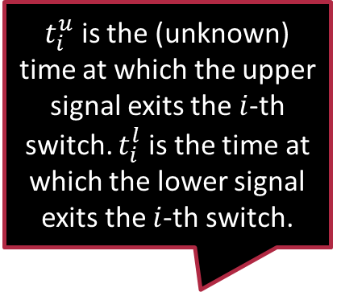






















A Twist in the Tale
$t_{i}^{u}$ is the (unknown) time at which the upper signal exits the $i$-th switch. $t_{i}^{l}$ is the time at which the lower signal exits the $i$-th switch.
An attacker can see responses on “few” challenges and use ML to predict responses on all other challenges ☹
Doesn’t matter even if 1024-bit challenges are used ☹
All switches different so $p_{1}≠p_{2}≠…,q_{1}≠q_{2}≠…$
$$c_{1}$$
$$c_{2}$$
$$c_{3}$$
$$c_{64}$$
$$t_{1}^{u}$$
$$t_{2}^{u}$$
$$…$$
$$t_{3}^{u}$$
$$t_{64}^{u}$$
$$p_{1}$$
$$p_{2}$$
$$p_{3}$$
$$p_{64}$$
$$r_{1}$$
$$r_{2}$$
$$r_{3}$$
$$r_{64}$$
$$s_{1}$$
$$s_{2}$$
$$s_{3}$$
$$…$$
$$t_{1}^{l}$$
$$t_{2}^{l}$$
$$t_{3}^{l}$$
$$s_{64}$$
$$t_{64}^{l}$$
$$q_{1}$$
$$q_{2}$$
$$q_{3}$$
$$q_{64}$$

Slide 13

A Twist in the Tale
Let’s look at the second switch as an example to see how the delays add up
Observe that the response is $0$ if $t_{64}^{u}<t_{64}^{l}$ and $1$ otherwise
Note that $t_{2}^{u}$ and $t_{2}^{l}$ depend on $t_{1}^{u},t_{1}^{l},p_{2},q_{2},r_{2},s_{2}$ and $c_{2}$
$c_{2}$ dictates which previous exit time ($t_{1}^{u}$ or $t_{1}^{l}$) gets carried forward in which branch, and $p_{2},q_{2},r_{2},s_{2}$ give us the delay introduced by the 2nd switch itself
$$c_{1}$$
$$c_{2}$$
$$c_{3}$$
$$c_{64}$$
$$t_{1}^{u}$$
$$t_{2}^{u}$$
$$…$$
$$t_{3}^{u}$$
$$t_{64}^{u}$$
$$p_{1}$$
$$p_{2}$$
$$p_{3}$$
$$p_{64}$$
$$r_{1}$$
$$r_{2}$$
$$r_{3}$$
$$r_{64}$$
$$s_{1}$$
$$s_{2}$$
$$s_{3}$$
$$…$$
$$t_{1}^{l}$$
$$t_{2}^{l}$$
$$t_{3}^{l}$$
$$s_{64}$$
$$t_{64}^{l}$$
$$q_{1}$$
$$q_{2}$$
$$q_{3}$$
$$q_{64}$$

Slide 14
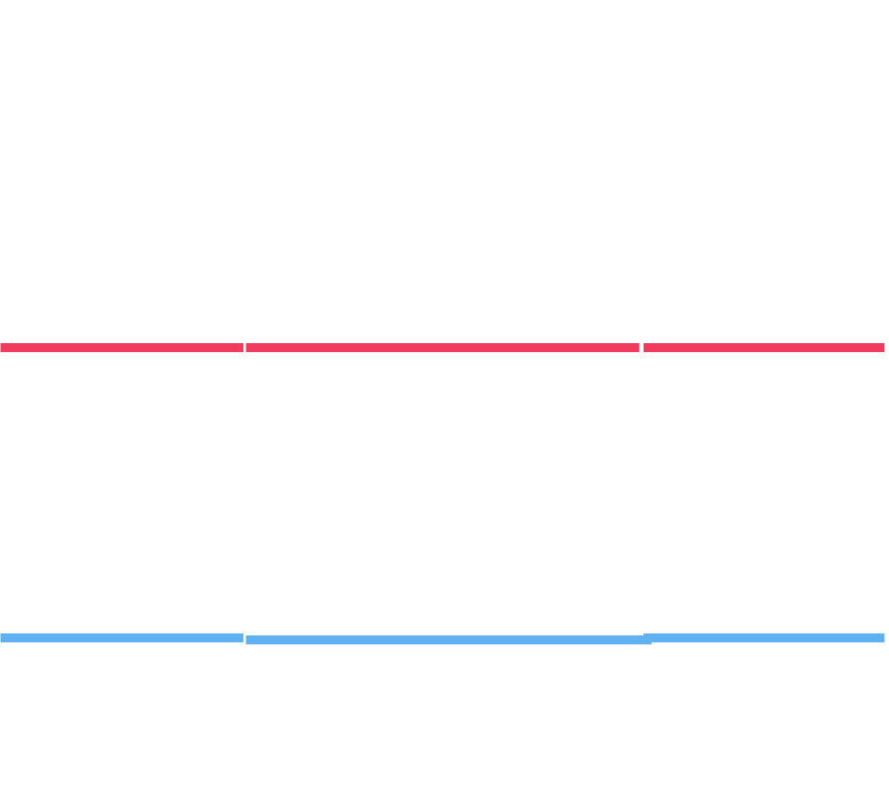
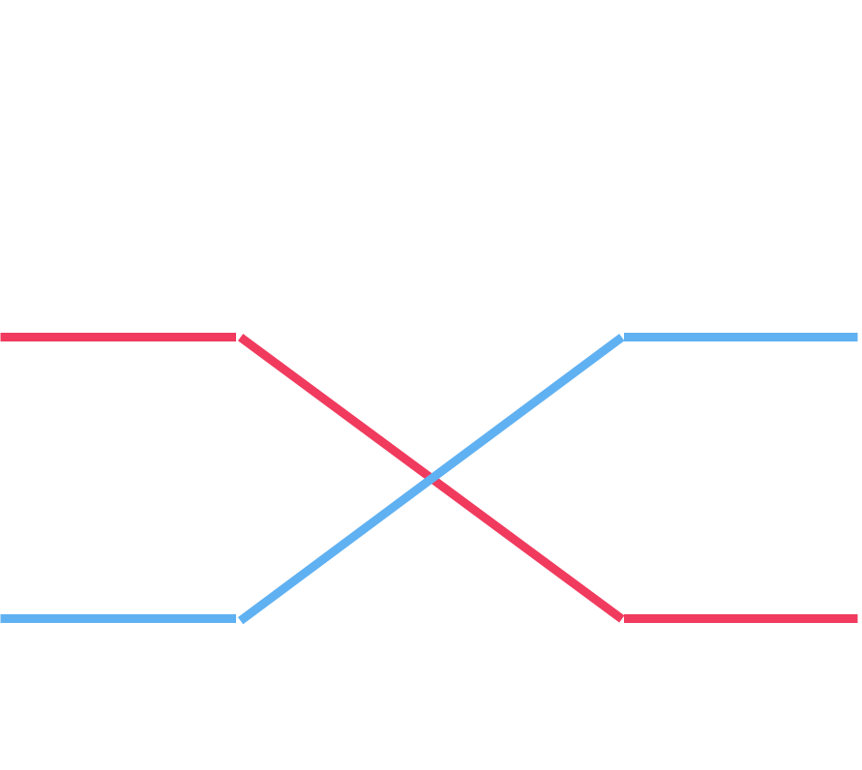











A Twist in the Tale
$$0$$
$$1$$
$$1$$
$$0$$
$t_{2}^{u}=\left(1−c_{2}\right)⋅\left(t_{1}^{u}+p_{2}\right)+c_{2}⋅\left(t_{1}^{l}+s_{2}\right)$
$t_{2}^{l}=\left(1−c_{2}\right)⋅\left(t_{1}^{l}+q_{2}\right)+c_{2}⋅\left(t_{1}^{u}+r_{2}\right)$
$$1$$
$$0$$
$$1$$
$$0$$
$$c_{1}$$
$$c_{2}$$
$$c_{3}$$
$$c_{64}$$
$$0$$
$$1$$
$$t_{1}^{u}$$
$$t_{2}^{u}$$
$$…$$
$$t_{3}^{u}$$
$$t_{64}^{u}$$
$$p_{1}$$
$$p_{2}$$
$$p_{3}$$
$$p_{64}$$
$$r_{1}$$
$$r_{2}$$
$$r_{3}$$
$$r_{64}$$
$$s_{1}$$
$$s_{2}$$
$$s_{3}$$
$$…$$
$$t_{1}^{l}$$
$$t_{2}^{l}$$
$$t_{3}^{l}$$
$$s_{64}$$
$$t_{64}^{l}$$
$$q_{1}$$
$$q_{2}$$
$$q_{3}$$
$$q_{64}$$

Slide 15
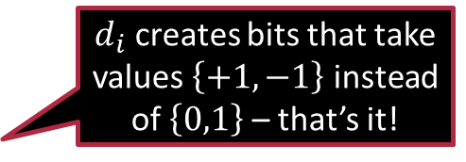

A little bit of Math ☺
Let us use the shorthand $Δ_{i}=t_{i}^{u}−t_{i}^{l}$ to denote the lag
Note: response is 0 if $Δ_{64}<0$ else response is 1
$Δ_{2}=\left(1−c_{2}\right)⋅\left(t_{1}^{u}+p_{2}−t_{1}^{l}−q_{2}\right)+c_{2}⋅\left(t_{1}^{l}+s_{2}−t_{1}^{u}−r_{2}\right)$
$=\left(1−2c_{2}\right)⋅Δ_{1}+\left(q_{2}−p_{2}+s_{2}−r_{2}\right)⋅c_{2}+\left(p_{2}−q_{2}\right)$
To make notation simpler, let $d_{i}≝\left(1−2c_{i}\right)$ $α_{i}≝\left(p_{i}−q_{i}+r_{i}−s_{i}\right)/2$ $β_{i}≝\left(p_{i}−q_{i}−r_{i}+s_{i}\right)/2$
$Δ_{2}=Δ_{1}⋅d_{2}+α_{2}⋅d_{2}+β_{2}$
$d_{i}$ creates bits that take values $\left\{+1,−1\right\}$ instead of $\left\{0,1\right\}$ – that’s it!

Slide 16


A little bit of Math ☺
Do you see a pattern emerging here too!
A similar relation holds for any stage $Δ_{i}=d_{i}⋅Δ_{i−1}+α_{i}⋅d_{i}+β_{i}$
We can safely take $Δ_{0}=0$ (absorb initial delays into $p_{1},q_{1},r_{1},s_{1}$)
We can keep going on recursively $Δ_{1}=α_{1}⋅d_{1}+β_{1}$ (since $Δ_{0}=0$)
$Δ_{2}=Δ_{1}⋅d_{2}+α_{2}⋅d_{2}+β_{2}$ : now plugin value of $Δ_{1}$ to get
$Δ_{2}={α_{1}⋅d}_{2}⋅d_{1}+\left(α_{2}+β_{1}\right)⋅d_{2}+β_{2}$
$Δ_{3}=α_{1}⋅d_{3}⋅d_{2}⋅d_{1}+\left(α_{2}+β_{1}\right)⋅d_{3}⋅d_{2}+\left(α_{3}+β_{2}\right)⋅d_{3}+β_{3}$
$Δ_{4}=α_{1}⋅d_{4}⋅d_{3}⋅d_{2}⋅d_{1}+\left(α_{2}+β_{1}\right)⋅d_{4}⋅d_{3}⋅d_{2}$ $+\left(α_{3}+β_{2}\right)⋅d_{4}⋅d_{3}+\left(α_{4}+β_{3}\right)⋅d_{4}+β_{4}$

Slide 17


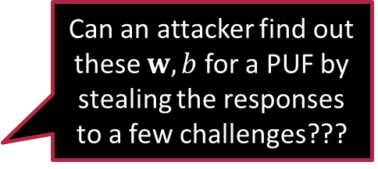

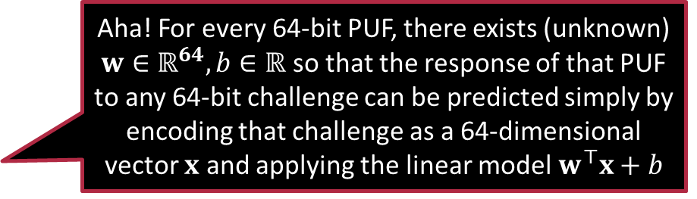
Cracks appear in the PUF
Aha! For every 64-bit PUF, there exists (unknown) $w∈ℝ^{64},b∈ℝ$ so that the response of that PUF to any 64-bit challenge can be predicted simply by encoding that challenge as a 64-dimensional vector $x$ and applying the linear model $w^{⊤}x+b$
It turns out that $Δ_{64}=w_{1} ⋅x_{1}+w_{2}⋅x_{2}+…+w_{64}⋅x_{64}+b$
If $Δ_{64}<0$, upper signal wins and answer is 0
If $Δ_{64}>0$, lower signal wins and answer is 1
where $x=\left[x_{1},…,x_{64}\right],w=\left[w_{1},…,w_{64}\right]∈ℝ^{64}$ $x_{i}=d_{i}⋅d_{i+1}⋅…⋅d_{64}$ $x_{i}=\left(1−2c_{i}\right)⋅\left(1−2c_{i+1}\right)⋅…⋅\left(1−2c_{64}\right)$ $w_{1}=α_{1}$ $w_{i}=α_{i}+β_{i−1} \left(for i=2,3,…,64\right)$ $b=β_{64}$
Thus, response is simply $\frac{sign\left(w^{⊤}x+b\right)+1}{2}$
$$w^{⊤}x+b$$
The linear models for different PUFs will be different but it will be a linear model every time!
Can an attacker find out these $w,b$for a PUF by stealing the responses to a few challenges???
You bet I can!

Slide 18

Cracking a PUF using Binary Classification
Step 1: steal “enough” challenge response pairs (CRPs) $\left(c^{1},r^{1}\right),…,\left(c^{n},r^{n}\right),c^{j}=\left[c_{1}^{j},…,c_{64}^{j}\right]∈{\left\{0,1\right\}}^{64},r^{j}∈\left\{0,1\right\}$
Step 2: encode CRPs $\left(c^{j},r^{j}\right)→\left(x^{j},y^{j}\right),x^{j}=\left[x_{1}^{j},…,x_{64}^{j}\right]∈{\left\{−1,1\right\}}^{64},y^{j}∈\left\{−1,1\right\}$
where $x_{i}^{j}=\left(1−2c_{i}^{j}\right)⋅\left(1−2c_{i+1}^{j}\right)⋅…⋅\left(1−2c_{64}^{j}\right)$ and $y^{j}=2r^{j}−1$
Step 3: learn a linear model $\hat{w},\hat{b}$ that does well at predicting $y^{i}$ on $x^{i}$
Note: just a simple binary classification problem!
Step 4: for any new challenge $c^{t}$, first encode it as $x^{t}$ and then find $\frac{sign\left({\hat{w}}^{⊤}x^{t}+\hat{b}\right)+1}{2}$ as the response
There exist several algorithms for learning linear models to solve binary classification problems
This is why people stopped using arbiter PUFs for authentication after this flaw was revealed

Slide 19

Lessons Learnt and Summary
ML can be used to reveal vulnerabilities in security protocols
Myriad ML applications in areas such as cybersecurity, hardware security, IoT
ML can also be used in nefarious ways e.g., to spy on people – need discipline
Prompted researchers to develop stronger PUFs (e.g., Ising PUF, LP-PUF, etc)
Need to closely study the application to identify best ML usage
For the PUF problem, closely inspect the delay structure
Original features/representation of a data point may be insufficient
For the PUF problem, cannot apply a linear model to $c^{j}$ to get the response
Needed to first find new, more informative features first e.g., $c^{j}→x^{j}$
In most areas, new feature vectors may have different dimensionality
Biggest achievement of deep learning – automate feature discovery

Slide 20

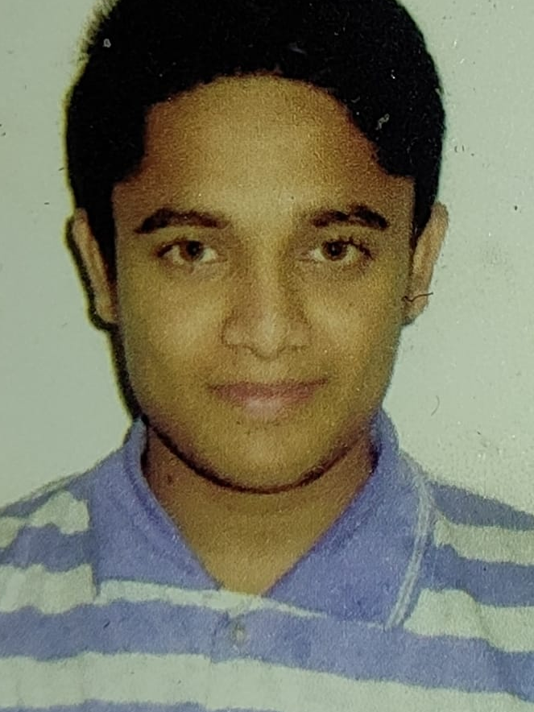

Thanks SETTLOR Team!
Prof. Urbi Chatterjee
CSE, IIT Kanpur
Manthan Kojage
MTech, CSE, IIT Kanpur
Neelofar Hassan
PhD, CSE, IIT Kanpur
Secure Embedded and Smart Things Laboratory (SETTLOR)
https://www.cse.iitk.ac.in/users/urbic/research/

Slide 21
Stay Fantastic
Catch-up with you next time

